Slide 1

XSL – Basic Understanding 1
APS
By Paul Aviles
Notes:
1

Slide 2

FIRST... Lets understand what XSL is

Slide 3

FIRST... Lets understand what's XSL
XSL stands for Extensible Stylesheet Language. It is used to parse and transform XML data to documents that will be later read and used by other platforms.
But how is it used by CAREERBUILDER?
Simple! We transform the XML provided by the clients to an XML with the format used by DPI (DPI is the platform where the jobs are posted in Careerbuilder).
3
© 2015 CareerBuilder
Notes:
Search account by DID or Email
Select the Add Users option
Fill in “New User Info” with first, last name and email
Grant Permissions if requested and hit “Add” before hitting “Save”
To change password, go to users and click on the user you have just created and click on change email/password
Enter the password and confirm it. Once you have confirmed it click update
Send the welcome email to the client if the Account Manager requests you to do so, if not send the user and password to the Account Manager
3

Slide 4

FIRST... Lets understand what's XSL
ADVANTAGES
The information processed by XSL is always guaranteed to work since XML data follows standard structures. Human error does not exists when an XSL code works.
4
© 2015 CareerBuilder
Notes:
Search account by DID or Email
Select the Add Users option
Fill in “New User Info” with first, last name and email
Grant Permissions if requested and hit “Add” before hitting “Save”
To change password, go to users and click on the user you have just created and click on change email/password
Enter the password and confirm it. Once you have confirmed it click update
Send the welcome email to the client if the Account Manager requests you to do so, if not send the user and password to the Account Manager
4

Slide 5

Now, what's XML?
(If you already familiar with it, feel free to skip this section)

Slide 6

Now, what's XML?
XML stands for Extensible Markup Language, it’s is a software- and hardware-independent tool for storing and transporting data.
The basic building block of an XML document are elements defined by tags. They define the scope of an element in the XML. An element has a beginning and an ending tag.
Most of them look like this:
As you can see, there are many tags like <JobID> within the document, each one contains a unique piece of information about the job that can be either the position ID, Title, Category or many others!
6
© 2015 CareerBuilder
Notes:
Search account by DID or Email
Select the Add Users option
Fill in “New User Info” with first, last name and email
Grant Permissions if requested and hit “Add” before hitting “Save”
To change password, go to users and click on the user you have just created and click on change email/password
Enter the password and confirm it. Once you have confirmed it click update
Send the welcome email to the client if the Account Manager requests you to do so, if not send the user and password to the Account Manager
6

Slide 7


Now, what's XML?
Structure of an XML
1) A prolog defines the XML version and the character encoding:
2) The next line is usually the root element of the document (<Jobs>):
3) The next line starts a <Job> element:
4) The <Job> element can have as many child elements as needed:
5) We close the <Job> element with </Job> and the same with </Jobs>
7
© 2015 CareerBuilder
Notes:
Search account by DID or Email
Select the Add Users option
Fill in “New User Info” with first, last name and email
Grant Permissions if requested and hit “Add” before hitting “Save”
To change password, go to users and click on the user you have just created and click on change email/password
Enter the password and confirm it. Once you have confirmed it click update
Send the welcome email to the client if the Account Manager requests you to do so, if not send the user and password to the Account Manager
7

Slide 8
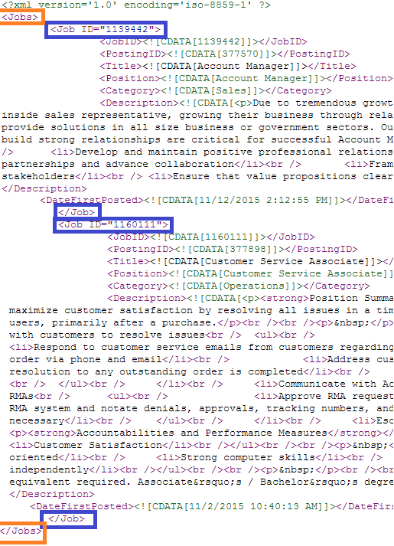
Now, what's XML?
Each job is usually contained
within a tag. This tag contains a collection of every job. We called it root element in the previous slide.
In the following example, the tag that contains this collection is called “Jobs” (Orange square).
The tag “Job” merely contains information of a single job. (Blue square).
8
© 2015 CareerBuilder
Notes:
Search account by DID or Email
Select the Add Users option
Fill in “New User Info” with first, last name and email
Grant Permissions if requested and hit “Add” before hitting “Save”
To change password, go to users and click on the user you have just created and click on change email/password
Enter the password and confirm it. Once you have confirmed it click update
Send the welcome email to the client if the Account Manager requests you to do so, if not send the user and password to the Account Manager
8

Slide 9

How is XSL done?

Slide 10

How is XSL done?
At APS, we use the following tools to develop XSL:
Notepad++
FAT Tool (Cloud Atlas)
Other useful tools:
*XSL and XML syntax checkers.
*Also transform documents
http://www.utilities-online.info/xsltransformation/
10
© 2015 CareerBuilder
Notes:
Search account by DID or Email
Select the Add Users option
Fill in “New User Info” with first, last name and email
Grant Permissions if requested and hit “Add” before hitting “Save”
To change password, go to users and click on the user you have just created and click on change email/password
Enter the password and confirm it. Once you have confirmed it click update
Send the welcome email to the client if the Account Manager requests you to do so, if not send the user and password to the Account Manager
10

Slide 11


How is XSL done?
Notepad++ is a very efficient code editor
since it supports many encoding and language
patterns for XML and XSL.
FAT tool is the tool provided by Career Builder to:
1) Retrieve XML files from external sources such as
web addresses or FTP files.
2) Use an XSL code to parse and transform the
Information of the retrieved XML file
3) Lastly, publish the transformed jobs by sending
them DPI.
11
© 2015 CareerBuilder
Notes:
Search account by DID or Email
Select the Add Users option
Fill in “New User Info” with first, last name and email
Grant Permissions if requested and hit “Add” before hitting “Save”
To change password, go to users and click on the user you have just created and click on change email/password
Enter the password and confirm it. Once you have confirmed it click update
Send the welcome email to the client if the Account Manager requests you to do so, if not send the user and password to the Account Manager
11

Slide 12

The XSL Code

Slide 13
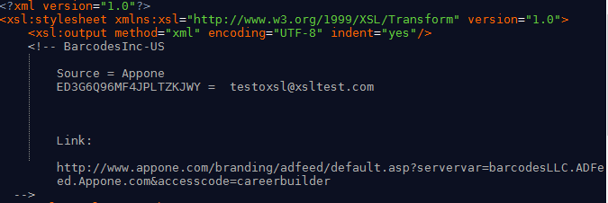
The XSL Code
XSL itself is kind of a programming language only focused on data transformation. An XSL code is built to parse information from the XML data containing the jobs and transform it to a format recognizable by DPI at CareerBuilder.
This is how the XSL code looks like:
13
© 2015 CareerBuilder
Notes:
Search account by DID or Email
Select the Add Users option
Fill in “New User Info” with first, last name and email
Grant Permissions if requested and hit “Add” before hitting “Save”
To change password, go to users and click on the user you have just created and click on change email/password
Enter the password and confirm it. Once you have confirmed it click update
Send the welcome email to the client if the Account Manager requests you to do so, if not send the user and password to the Account Manager
13

Slide 14
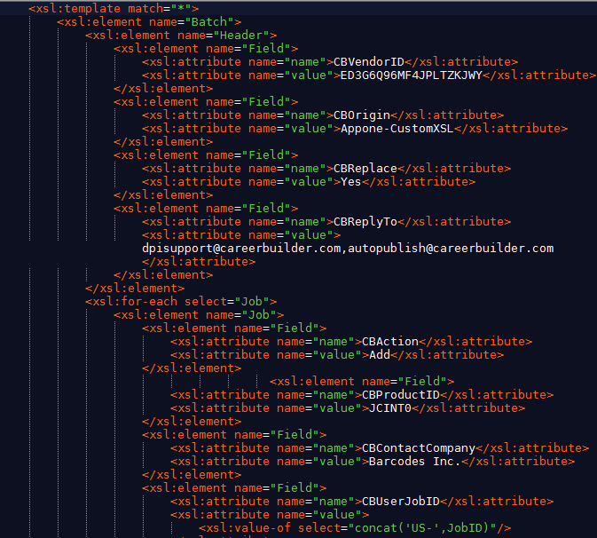
The XSL Code
Like in XML, each tag contains an important value.
This part of the XSL would generate the following output:
<Batch>
<Header>
<Field name='CBVendorID' value='ERSFFDAFDAFGDEASF'/>
<Field name='CBReplyTo' value='test@careerbuilder.ocm'/>
</Header>
….
14
© 2015 CareerBuilder
Notes:
Search account by DID or Email
Select the Add Users option
Fill in “New User Info” with first, last name and email
Grant Permissions if requested and hit “Add” before hitting “Save”
To change password, go to users and click on the user you have just created and click on change email/password
Enter the password and confirm it. Once you have confirmed it click update
Send the welcome email to the client if the Account Manager requests you to do so, if not send the user and password to the Account Manager
14

Slide 15
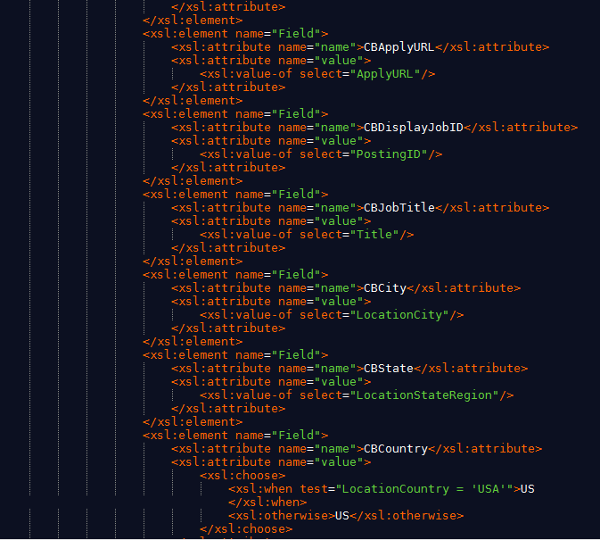
The XSL Code
...
<Field name="CBApplyURL" value="http://jobsite.com" />
<Field name="CBDisplayJobID" value="123" />
<Field name="CBJobTitle" value="TX" />
<Field name="CBCity" value="San Antonio" />
<Field name="CBState" value="CA" />
<Field name="CBCountry" value="US" />
….
15
© 2015 CareerBuilder
Notes:
Need instructions from Corbus
15

Slide 16
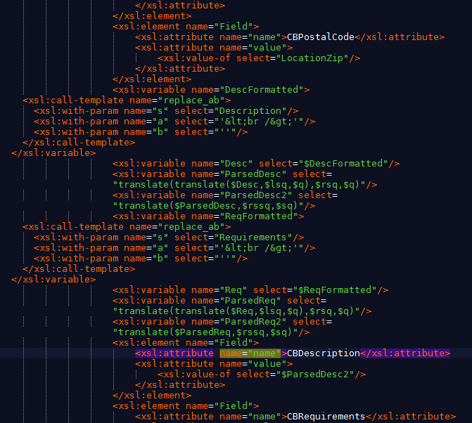
The XSL Code
...
<Field name="CBPostalCode" value="This job is about building stuff" />
<Field name="CBDescription" value="123" />
<Field name="CBRequirements" value="You need tools" />
<Field name="CBCity" value="San Antonio" />
<Field name="CBState" value="CA" />
<Field name="CBCountry" value="US" />
</Batch>
16
© 2015 CareerBuilder
Notes:
Need instructions from Corbus
16

Slide 17
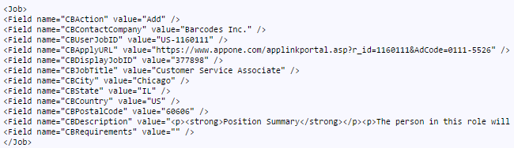
The XSL Code
This is the final result:

Slide 18
QUESTIONS?
© 2015 CareerBuilder

Slide 19
LET’S PROCEED CREATING PROGRAMMING AN XSL FILE.
© 2015 CareerBuilder

